Slide 1
MasQuerade
“Faces on parade…”

Slide 2
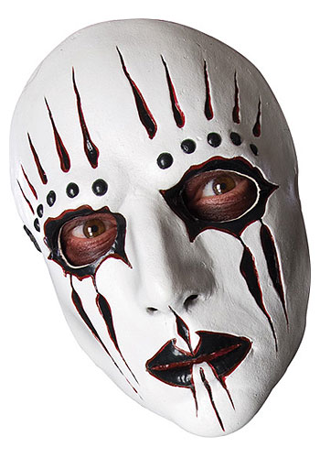
Journal Warm Up?
Introduction:
We all wear masks in life. Some wear them to fit in, other wear them to stand out. Some people uses masks to perform great things. Others hide behind them.
What masks do you wear on a frequent basis? (Make a list)
Why do you wear these masks?
If you honestly feel you never wear a mask, explain.

Slide 3
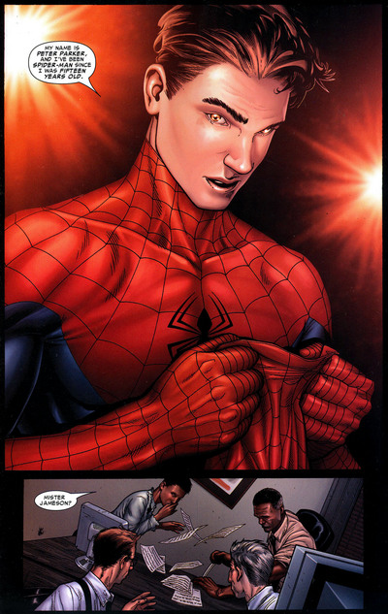
Your Mission
Create a short scene which depicts someone choosing to don a mask in order to deal with a situation.

Slide 4
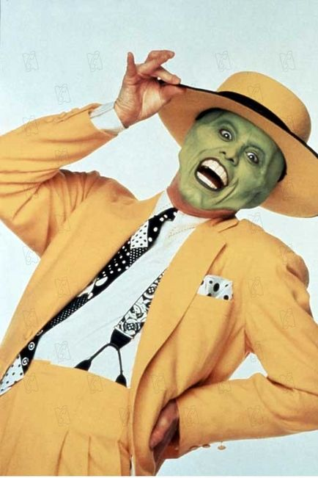
What Does a Good Scene Have?
Exposition: Quickly establish when/where/why the situation is taking place. Introduce the main character
Rising Action: What is the problem presented? How will the main character respond?
Climax: The main character chooses (perhaps reluctantly) to wear a “mask”
Falling Action/Conclusion: What is the result of this choice? End the scene.

Slide 5
Other Thoughts
USE THE MASKS!!- You can have one or many characters where them whenever you feel they are acting in an unusual way.
EVERYONE MUST SPEAK- Some parts are bigger than others, but everyone has a role.
BE CREATIVE- The only restriction is that it remain school appropriate. Everything else is on the table.
Set it on Zombie Planet if you want…

Slide 6
How Do I get Started?
Use the handout to come up with a story. Once you finish, begin drafting your scripts.
Everyone will need a copy of the script. Someone must either type and print it, or copy it in the library after/before school.
Scripts are allowed, but memorization is better
Use the period to work and rehearse. There will be minimal work time tomorrow.
Scenes should be at least five minutes long.

Slide 7
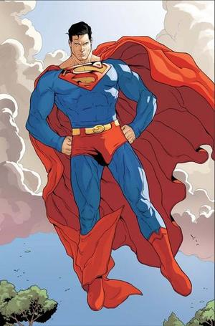
Tomorrow
Act out the skits
Audience will try to guess for what idea the “mask” is a metaphor
Any questions, please ask.
Have fun…Or don’t. But it’s better if you have fun.

