Slide 1

To Begin
Click the “Slide Show” tab at the of the screen
Now click “From Beginning”
(Far Left Button)
Good luck,
Mr. Harrold

Slide 2

How to Write a Paper

Slide 3

What is happening?
This is an Interactive PowerPoint
To advance the slides, click the arrow
To go back, click the arrow.
READ ALL THE SLIDES!!!! Take notes as you go!
Follow along in your Paper Packet. This well help when you start writing.

Slide 4
Instructions Continued
When you get to a question slide, click your answer choice.
If wrong, go back and try again.
Example: What should you do while reading the PowerPoint?
Nothing
Take Notes
Talk to a friend
Click randomly

Slide 5

Nope!
You’ve selected the wrong answer. Try again
Click the back arrow to go back!

Slide 6
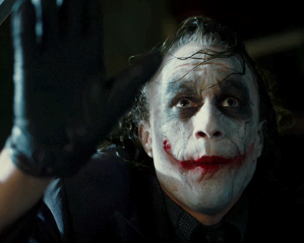
Good!
You’re ready to go! If you get really stuck, raise your hand.
Have fun!
“And here…we…….go!”

Slide 7
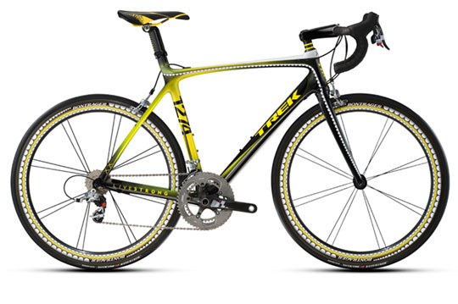
Step 1: Thesis
Arguable Point
All good writing needs a thesis
A thesis has two parts:
Arguable Point and Premises
If either is missing, the thesis is terrible
Premises

Slide 8
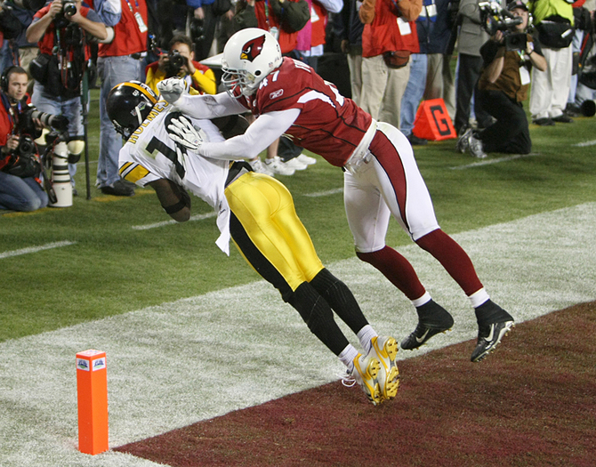
What is an Arguable Point?
1. A statement which isn’t obvious.
2. A statement which could (and should) be debated
3. A statement you can defend (not an opinion only)
Did his feet touch the ground?
Some would argue this point

Slide 9
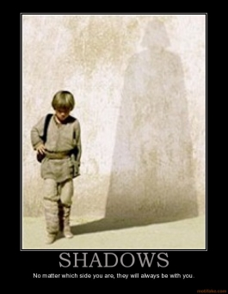
Examples
Read these examples:
Anakin Skywalker is Darth Vader.
  Everyone knows that. There is nothing to debate. (bad example)
Anakin is a metaphor for the dangers of impatience.
  This point can be debated. There are many sides to this issue. This can be proven (Good Example)

Slide 10
Which of the following is an
Arguable Point?
The Germans killed many Jews during the Holocaust.
The Holocaust was a tragic event in Elie’s life.
The Holocaust changed the way the world works.
Night tells the story of young boy during the holocaust.

Slide 11
False
This statement is pretty self-explanatory. Not very many people would argue with you on this one.
Click the button to try again

Slide 12

Exactly!
The Holocaust changed the way the world works is very debatable!
People could ask these questions:
  How has it changed the world?
  Did it REALLY change the world? Prove it!!
  Is this a positive or negative change?
  Who cares about the Holocaust?

Slide 13
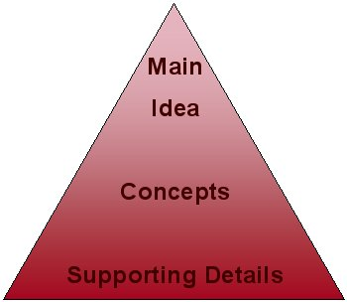
What is a Premise?
A premise backs up an arguable point.
Answers the “prove it” question
  (i.e. The holocaust changed the world forever? Prove it!)
Ex. The Holocaust changed the world forever by showing that evil still exists and compelling people to stand up for the victims.
(Premises are in Bold)

Slide 14

Which of these is NOT a premise?
A.P.- Star Wars is the most influential American movie ever because…
It launched a new era of special effects.
It was really good
It changed box office projections for sci-fi movies
It combined space and mythology for the first time

Slide 15

Sorry, Try Again
This is actually a great topic for a premise.
It supports the thesis, it has potential for a full paragraph and it is a provable argument
Try again?

Slide 16

Exactly!
Saying “It was good” is a terrible premise
It is much too broad, it is unable to be proven , and it restates the A.P.
Click the arrow to CONTINUE!

Slide 17

Write your own thesis!
For class tomorrow, write three arguable points as practice
Tomorrow, we will review thesis creation and move on with the project
If curious about the rest of the paper, click here____
Confused? Go Back!

Slide 18
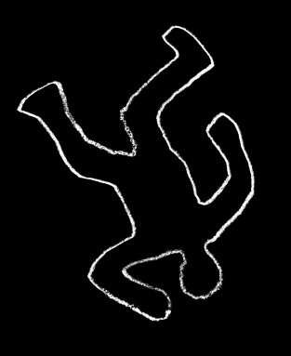
Outline
Each Body Paragraph Needs:
A Topic Sentence (Your Premise)
Two Quotes
One Specific Example (not a quote)
Conclusion Sentence

Slide 19
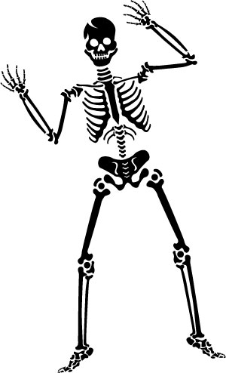
Skeleton Outline
I. Introduction
II. Body 1
  A. Idea 1
  1.Quote 1
  B. Idea 2
  2. Specific 1
III. Body 2
  A. Idea 1
  1.Specific 2
  B. Idea 2
  2. Quote 2
  IV. Conclusion

Slide 20
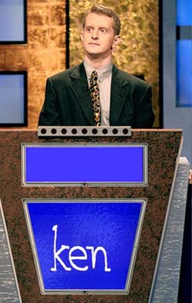
Check for Understanding
How many paragraphs will the entire paper be?
A. 4
B. 5
C. 3
D. 2

Slide 21
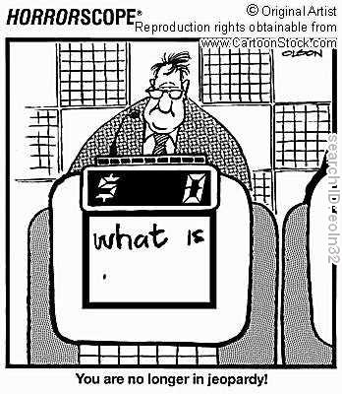
Incorrect
Not Quite. Remember to count introduction, conclusion and three body paragraphs.
Try again

Slide 22
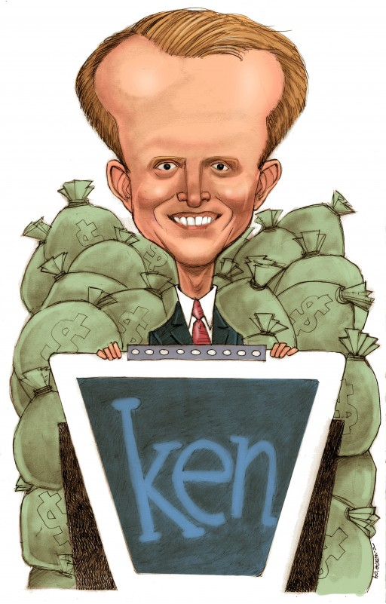
Correct!
Exactly!
The paper will have One Introduction, One conclusion, and three body paragraphs

Slide 23

Using a Quote
Quotes do not work alone!!
Quotes need a “lead-in” and “lead-out”
A Lead-in introduces the quote, often just a few words

Slide 24
Find the Lead-In
In Night, Elie states that “I dreamed for a world with no bells” (52). Elie has heard the bell so much, he now associates the bell sound with the Nazi orders. By wishing for a world without bells, Elie hopes for a future free of Nazi control. This ultimately shows how Elie’s struggle represents humanity’s struggle for freedom.
“I dreamed for a world with no bells”
In “Night”, Elie states that…
Elie hopes for a future free of Nazi control

Slide 25
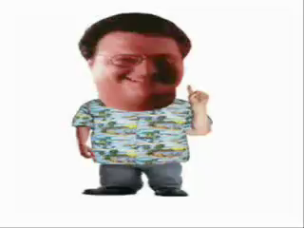
Nope!
Remember, a lead-in prepares the reader for the quote and is often only a few words
Try again.
“Ah, ah, ah. You didn’t say the magic word…”

Slide 26

Correct!
The Lead-In is only a few words which prepare the reader for the quote!
Continue!

Slide 27

Quote Notes
All text used from the book is a quote, not just dialogue.
Quotes must be in quotation marks.
All quotes must be followed by a page number in parentheses. (Period is last!!)
i.e. “I dreamed for a world with no bells”(52).

Slide 28
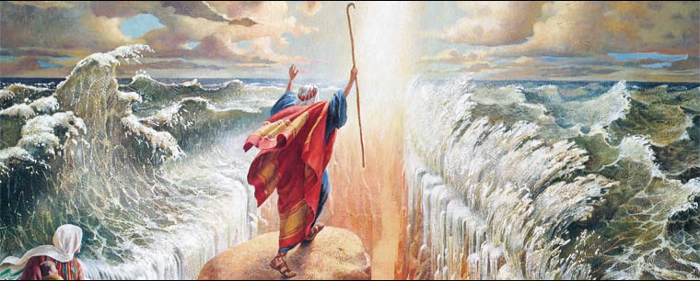
Lead-Out
A Lead-Out comes after the quote
It does three things:
  Explains the quote/evidence in context
  Connects the quote/evidence to the premise of the paragraph
  Analyzes how the premise supports the Arguable Point in the thesis
  Must be at least 3 sentences!
The First “Lead Out”

Slide 29
Find the Lead-Out
In “Night”, Elie states that “I dreamed for a world with no bells”(52). Elie has heard the bell so much, he now associates the bell sound with the Nazi orders. By wishing for a world without bells, Elie hopes for a future free of Nazi control. This ultimately shows how Elie’s struggle represents humanity’s struggle for freedom.
Elie has heard the bell so much, he now associates the bell sound with Nazi orders
By wishing for a world without bells, Elie hopes for a future free of Nazi control
This ultimately shows how Elie’s struggle […] for freedom
All of the Above

Slide 30

Almost…
You’re not wrong, but there’s a better answer…
Try again.

Slide 31
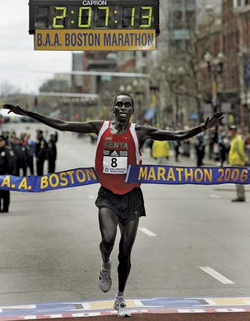
Yes!
All three sentences are correct!! They are all needed to explain the quote and back up the thesis
Continue

Slide 32
Final Thoughts
Your task: Open your paper packet
  Turn to the “Body paragraph” drafting guide and begin planning and drafting your body paragraphs
  Use this PowerPoint and the guide if you need help
  We will work on Body Paragraphs on Friday and Monday
  Thursday, we will review Introductions and Conclusions
  Written Body Paragraphs (Handwritten) will be due Thursday, September 22nd.
  I will be conferencing with you individually over the next two days
  Use the website to ask me questions if you are confused.
  www.mrharrold.com/multi-paragraph-essay.html

Slide 33

What would you like to do now?
End Power Point?
  Click Esc.
Restart PowerPoint?
Go to Section:
  Thesis
  Outline
  Lead-In
  Lead-Out

