Slide 1
Mafia Game Reflection
Who seemed the most guilty during the town meetings? Why?
Who were the people you trusted and listened to the most? Why?
How did it feel to be judged?

Slide 2
What is Evil?

Slide 3
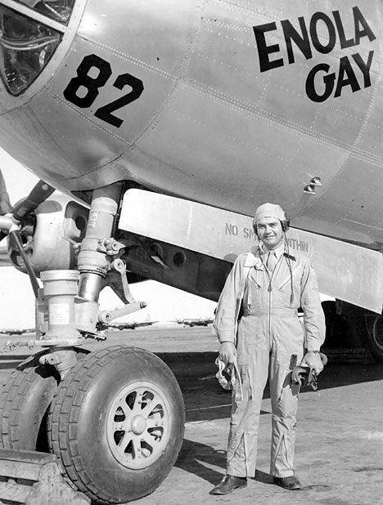
Number 1
The Pilot dropped the atomic bomb on Hiroshima.

Slide 4
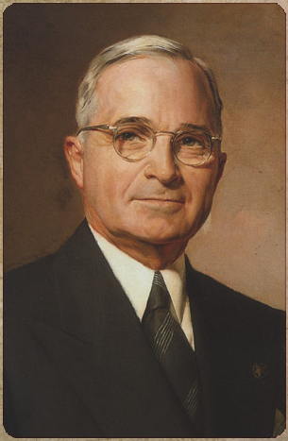
Number 2
The President ordered the man to design the bomb and the pilot to drop it.

Slide 5
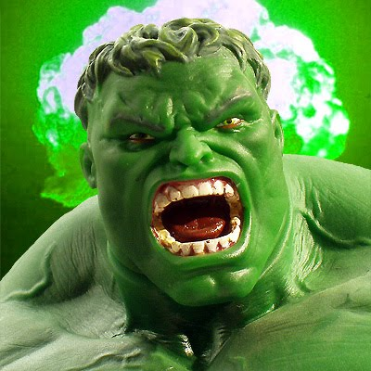
Number 3
A man kills his friend in a fit of blind rage.

Slide 6
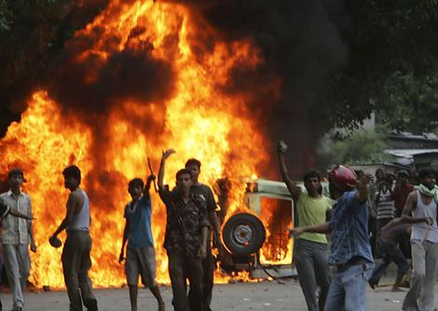
Number 4
An oppressed man leads a savage revolt…

Slide 7
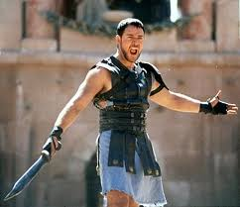
Number 5
An oppressed man kills his oppressor; gains his freedom.

Slide 8
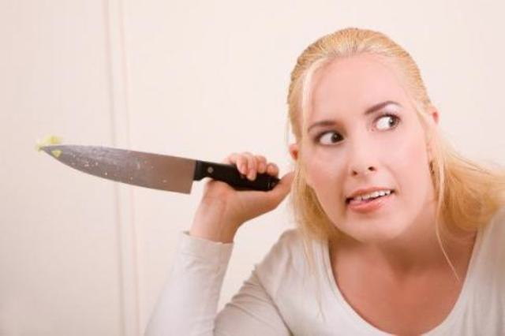
Number 6
An abused woman kills her husband while he sleeps

Slide 9
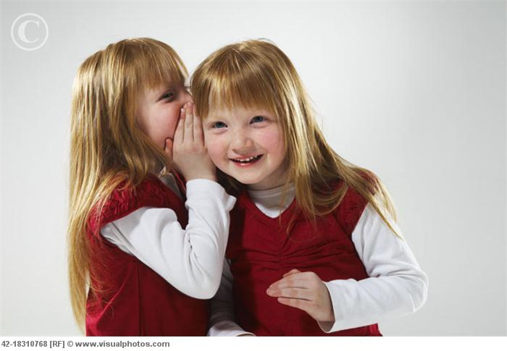
Number 7
You tell a close friend a secret…it doesn’t go well…

Slide 10
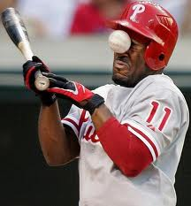
Number 8
An MLB pitcher hits another player on purpose

Slide 11
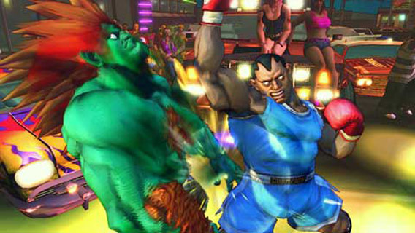
Number 9
A professional boxer hits an opponent and kills him.

Slide 12
Number 10
A person with AIDS sleeps with several people and does not mention his/her disease.

