Slide 1
How to Save the World

Slide 2
Challenge
Imagine you are in a position of authority over the American (or Global) government.
You have as much “real” power as you need (i.e. no magic is allowed)
Create four laws which will make the world a perfect place
When finished, write your laws on the board.

Slide 3
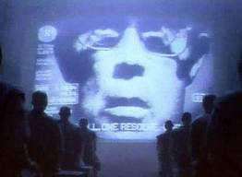
Look at the Laws
With which laws do you agree?
With which laws do you disagree?
Why?
Is any of this practical?

Slide 4
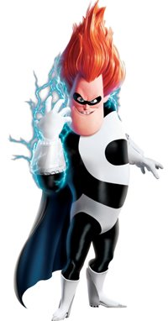
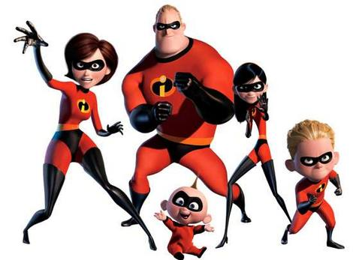
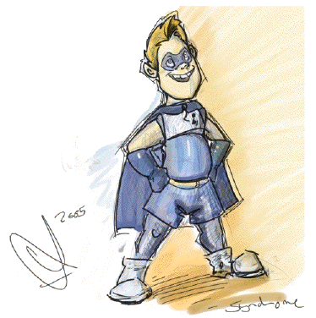
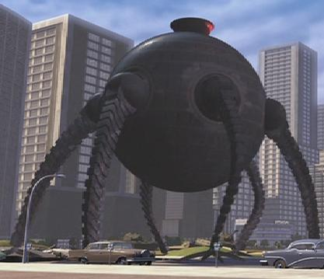
The Incredibles
Two retired superheroes, now with a children and suburban life, are called out of retirement
They are summoned to an island by the villain Syndrome (former friend of the Incredibles)
Once on the island, they must fight for their lives, and save the world

Slide 5
Quiz
Syndrome says “Everyone will be Super. Everyone! And when everyone is super…no one will be.”
How does this statement relate to “Harrison Bergeron”? What actions has the government created to make everyone “super”? How has this resulted in no one being “super”?
Provide at least three different examples from the story in a fully formed paragraph.

