Slide 1
A Brief History

Slide 2
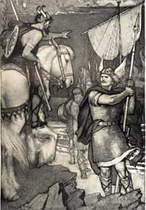
Beowulf
and the Anglo-Saxon Period

Slide 3
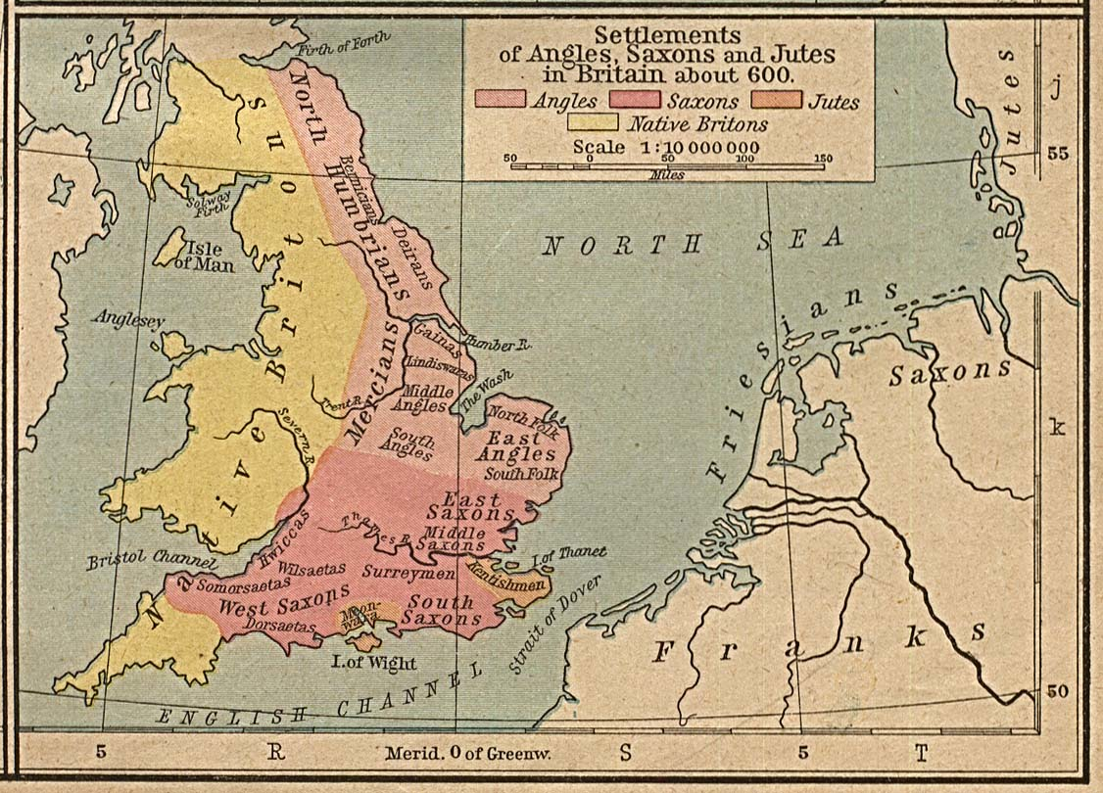
The Anglo-Saxon Period
Britain’s early years were dominated by waves of invaders.
Romans (left in the early fifth century)
Germanic Tribes
Angles
Saxons
The main part of Britain was settled by the Angles and the Saxons and took on a new name, Angle-land or England

Slide 4
History of England: 4th Century – 1066 AD
43BC-410AD: Roman Empire controls England
400’s BC: The Celts inhabit England
400’s-1066AD: Anglo-Saxons inhabit England
1066AD: Normans conquer England

Slide 5
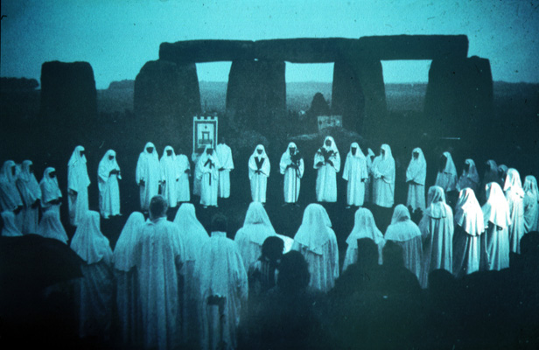
The Celts: 400BC-43BC
Inhabitants →
Briton tribe = “Britain”
Religion:
Priests - Druids
Beliefs - spirits in nature
Practices - ritual dances, sacrifices (human)
Themes:
Magic, Violence, Passion, Adventure
Druid priests at Stonehenge worshipping the summer solstice (beginning of summer)…still a mystery how this monument was built

Slide 6
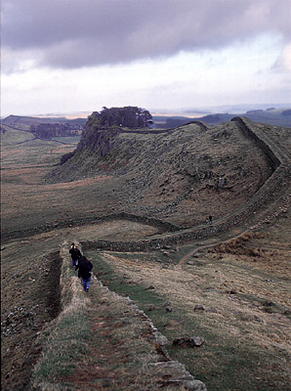
Roman Britain: 43BC-410AD
Roman Influences:
Economy and trading
Organized government
Lasting settlements (cities)
Transportation (roads)
Protection – Hadrian’s Wall
(15 ft tall)
Romans left Britain when forced back to Italy to defend homeland

Slide 7
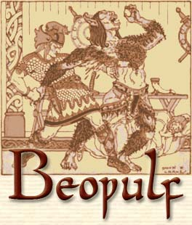
Anglo-Saxon Culture
Anglo-Saxon culture became the basis for English culture.
The gutteral, vigorous Anglo-Saxon language became the spoken language of the people
The language is now known as Old English

Slide 8
Old English

Slide 9
Anglo-Saxons: 400’s-1066AD
Invading Tribes:
Angles from Germany
Saxons from Germany
Jutes from Denmark
Kent

Slide 10
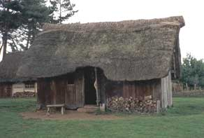
Anglo-Saxons
Settlements:
Main Hall
Where King would entertain people with storytellers, hold meetings and parties
Wooden Barricade
To keep out monsters and other evil creatures

Slide 11
Anglo-Saxons
GOD
Society: tribes focused on loyalty between leaders and followers
Warriors would serve King
King would give warriors lands, riches, and titles
KING
WARRIORS (Thanes)
SLAVES

Slide 12
Anglo-Saxons
Religion: mix of pagan and Christian values
Early Anglo-Saxons – Pagan | Influence of Christianity-597AD
No afterlife – goal is earthly glory | Afterlife in heaven/hell, goal is morality
Live for honor, pride, and reputation | Against human pride
Law of Revenge | Law of Forgiveness
Many gods, spirits | One God

Slide 13
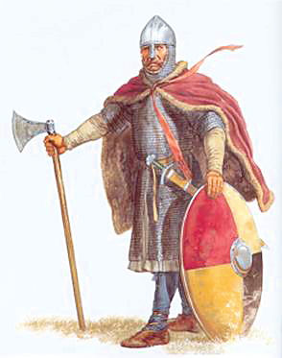
The VIKINGS invade…
In the 790s, a new group of invaders came to England.
The Vikings
Fearsome
Seafarers
Carried giant battle-axes
From Denmark and Norway
The Vikings found England more pleasant than their icy homeland.
They set up camps and gained control of the areas to the north and east of country.

Slide 14
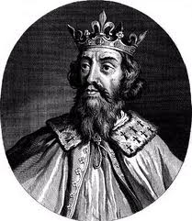
Alfred the Great
The Vikings (Danes) finally met defeat in the south at the hands of a powerful Anglo-Saxon king, Alfred the Great.
He unified the English under his rule. Education and culture flourished.

Slide 15
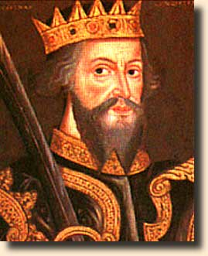
The Norman Conquest
In 1066, Alfred the Great’s successor, Harold, was defeated by William the Conqueror and his Norman army, who was crowned King of England.
The Norman Conquest ended the Anglo-Saxon rule in England.
Anglo-Saxons lost their land and the noble families fell into peasantry.

Slide 16
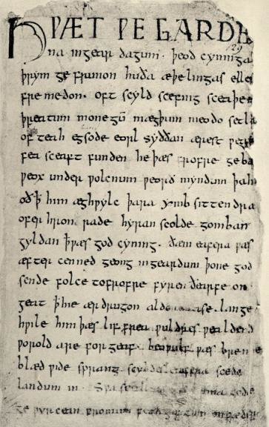
Literature of the Anglo-Saxon Period
Early literature took the form of lengthy epic poems that praised heroic warriors.
They reflected the harsh, brutal reality of life during the time.
The Anglo-Saxons gathered in great mead halls, where they feasted and listened to scops-professional poets, who brought the epic poems to life. The poems were chanted along to a harp and captivated the audience for hours.
The epic poems were far more than simple entertainment, they were a history lesson, moral sermon, and pep talk rolled into one.

Slide 17
Characteristics of an Epic Poem, the Hero
All epic poems concern the actions of an epic HERO
noble birth or high position
character traits that reflect ideals of society
perform courageous, superhuman deeds
perform actions that determine the fate of a nation or group of people
Beowulf Arrives

Slide 18
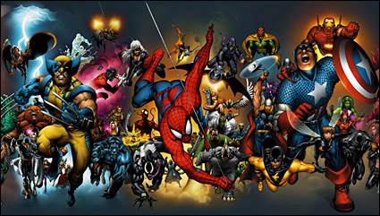
Questions?
How is the 'age of heroes', and the warrior culture of the 6th Century, represented in this clip from the film?
What values or ideas seem to be important to these men?

Slide 19
Characteristics of an Epic Poem
Setting is vast-involving more than one country
Plot is complicated by supernatural beings/events that involve dangerous journeys
Dialogue is long and formal
Theme reflects courage and honor, good and evil, life and death

Slide 20
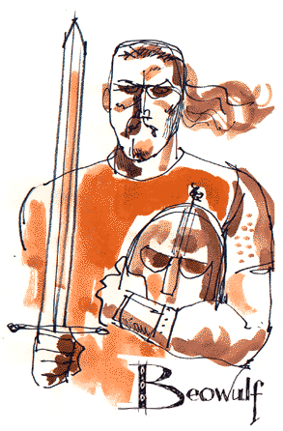
Beowulf
About 750?
The author is unknown
The poem was originally recited by scops, but one surviving manuscript, written by a Christian monk exists– written in Old English
Christian influence is evident in the poem
Although it was written in England, the poem describes events that take place in Scandinavia around the 500s.
Danes of Denmark
Geats of Sweden
Beowulf celebrates warrior culture requiring great strength and courage

Slide 21
While reading you will find…
alliteration: repetition of consonant sounds at the beginning of words
caesura: pause dividing each line
kenning: metaphorical compound word or phrase substituted for a name or a noun
Grendel→ “mankind’s enemy”

