Slide 1
Arthurian Legends
Rules and Codes of Living in the 1400’s

Slide 2
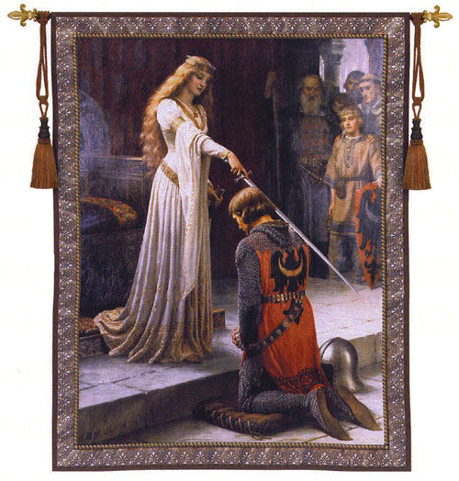
The Chivalric Code
Focus on The Men
Describe the scene in the painting – What do you see, what is going on, describe the setting (where and when)?
Describe the man kneeling – What does he look like, his personality, his job?

Slide 3
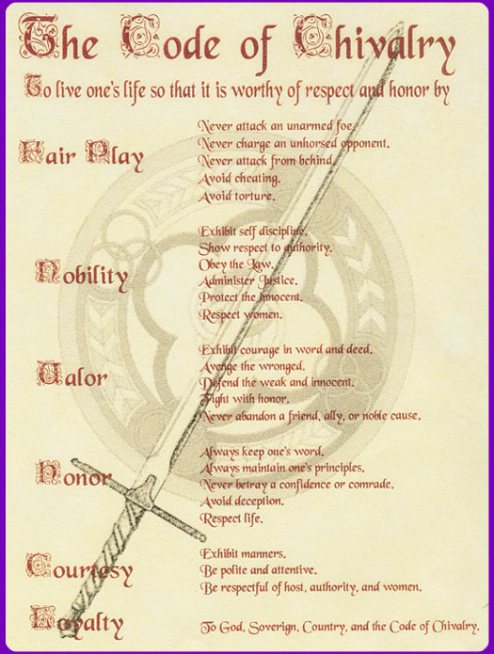
The Chivalric Code
Definition: rules of behavior for knights and noble women during the Middle Ages

Slide 4
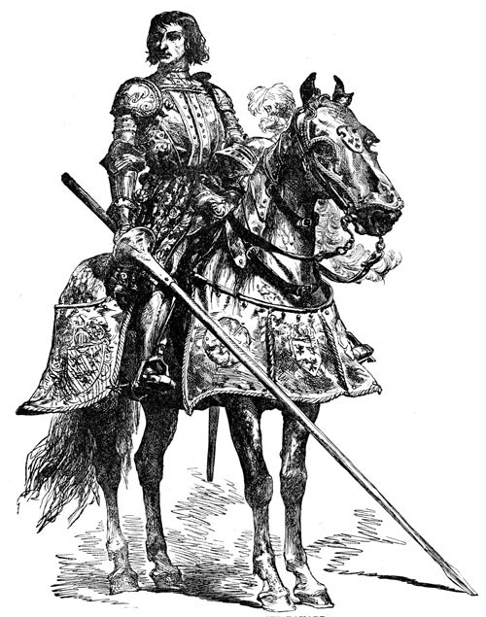
The Rules of Knighthood
Be loyal to and defend your lord/king
Respect, adore, and serve women
Be merciful, honest, and generous
Always fight for just causes (good reasons)
Never do battle with an unarmed man
Obey the teachings of Christianity
Protect the less fortunate

Slide 5
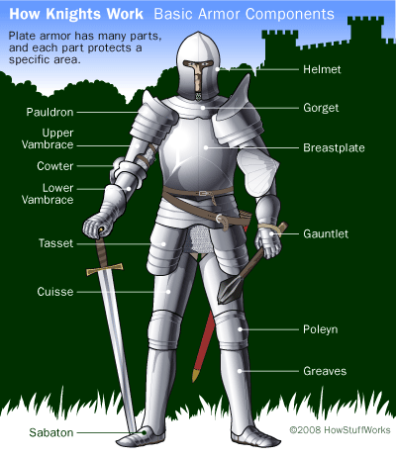
The Life of a Knight
Born into nobility – upper class
Train as a squire, prove worth on a dangerous quest
Knighted by royalty – dubbed on shoulder with sword
Swear to protect king, queen, and kingdom
Go on adventures, follow rules of knighthood

Slide 6
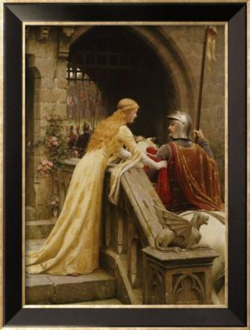
Courtly Love
Focus on The Women
Describe the scene in the painting – What do you see, what is going on, describe the setting (where and when)?
Describe the woman – What does she look like, her personality, her interaction with the knight?

Slide 7
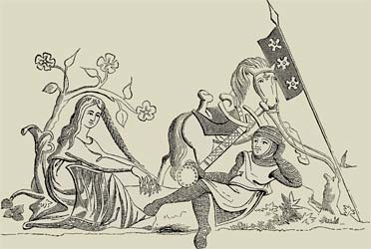
Courtly Love
Definition
Rules for love people were supposed to follow during the Middle Ages; included the idea that acting in the name of a lady would inspire a knight to perform brave deeds

Slide 8
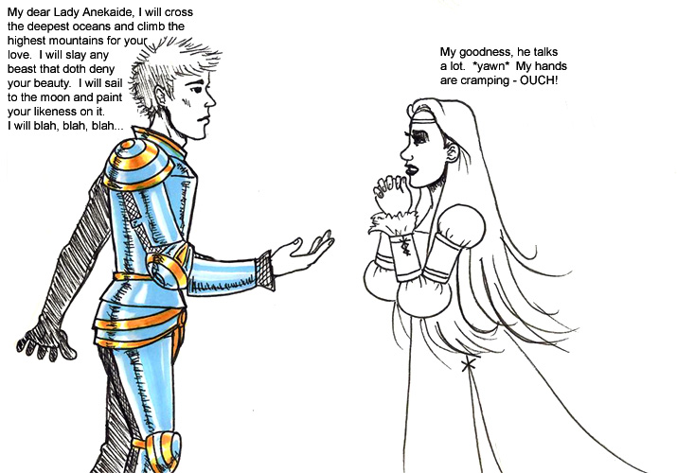
The Rules of Courtly Love
Which do you agree/disagree with?
Jealously increases the feeling of love.
A double love cannot exist.
Love is always increasing or decreasing.
Boys do not love until they reach the age of maturity.
When one lover dies, the widow must stay single for two years.
When love is made public, it fails to last.
A love that is difficult to get is more valuable to the lover.

Slide 9
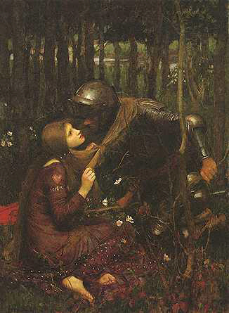
The Rules of Courtly Love (Cont.)
Every lover regularly turns pale in the presence of his beloved.
Nothing forbids one woman being loved by two men or one man by two women.
Love will make a lover to anything for his beloved.
A new love makes a lover forget about an old love.
He who is in love eats and sleeps very little.
One in love is very suspicious and protective of his love.
A true lover is constantly thinking about his beloved.
Once love is gone, it never returns.

