Slide 1
Body Paragraphs
How to…

Slide 2
Four Major Parts
Topic Sentence
Quote Sandwich
Example Sandwich
Conclusion Sentence

Slide 3
Topic Sentence
This will be a restatement of the premise from the thesis.
Ex. “One way Elie shows the loss of innocence is seen through....”
This will tell the audience the theme of the paragraph.

Slide 4
Quote “Sandwich”
Three parts: Lead-In, Quote, Lead Out
Lead-In: A few words to set up the quote.
Quote: Any text from the book word-for-word. Needs quotation marks and a page number.
Lead-Out: At least four sentences: Explain the quote, connect it to the premise and connect the premise to the thesis.

Slide 5
Examples:
Lead-In: One example of this is….
(Very few words, gets the quote ready)
“This is an example quote”(2)
Lead-Out: This quote occurs during Elie’s train ride. His obvious frustration shows he no longer sees the world as merely a “black” and “white”. By realizing the world can be evil, he loses innocence. The train ride is a key event in which Elie loses his old world view.

Slide 6
Specific Example Sandwich
Identical to a Quote Sandwich, but without a quote
Lead-In, Example, Lead-Out
You must still explain the example, connect it to the premise, connect it to the thesis, and conclude.

Slide 7
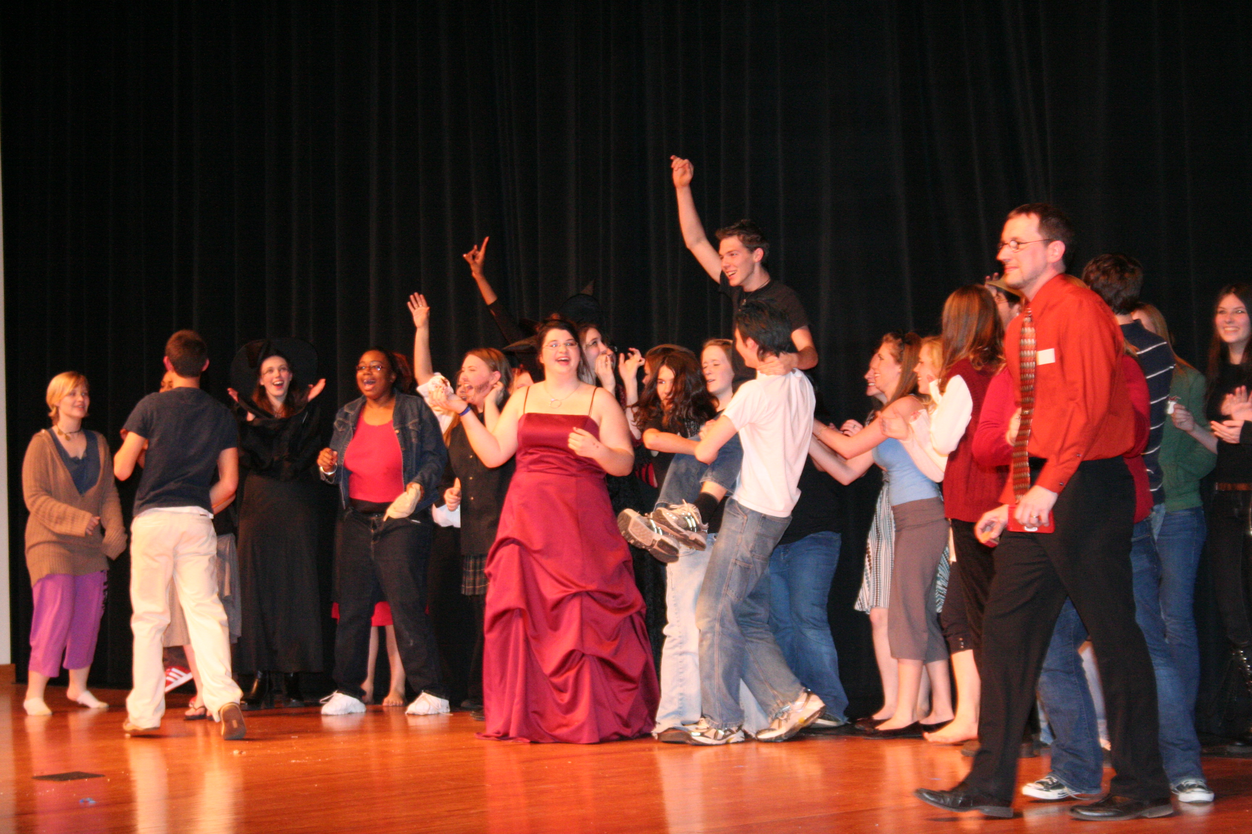
Conclusion Sentence
Restate the topic sentence
Prepare the reader for
the next paragraph
That’s about it.

Slide 8
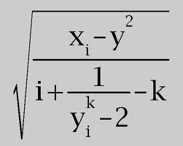
Math Time
Topic Sentence = 1 Sentence
Quote Sandwhich (Lead-In plus Quote plus Lead-Out)- 4 sentences
Repeat
Repeat
Conclusion- 1 sentence
Each Paragraph must be….?

Slide 9
Questions?

Slide 10
Today
Goal: Complete Body Paragraph 1 in class
I will meet with everyone today and tomorrow. If you have an urgent question, write your name on the board. I will address those people first.
Everyone else will be called up one by one.
If I don’t get to you today, feel free to email me your thesis and I will get back to you tonight.

